Slide 1
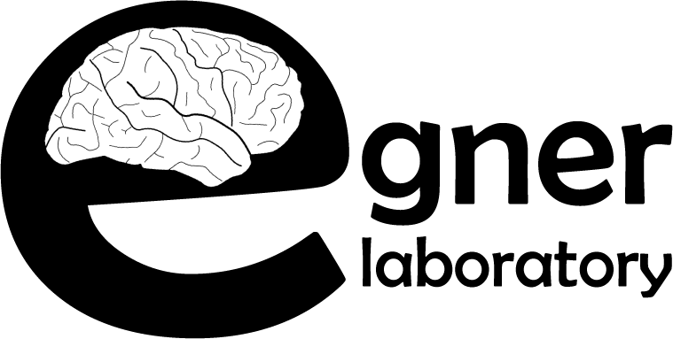
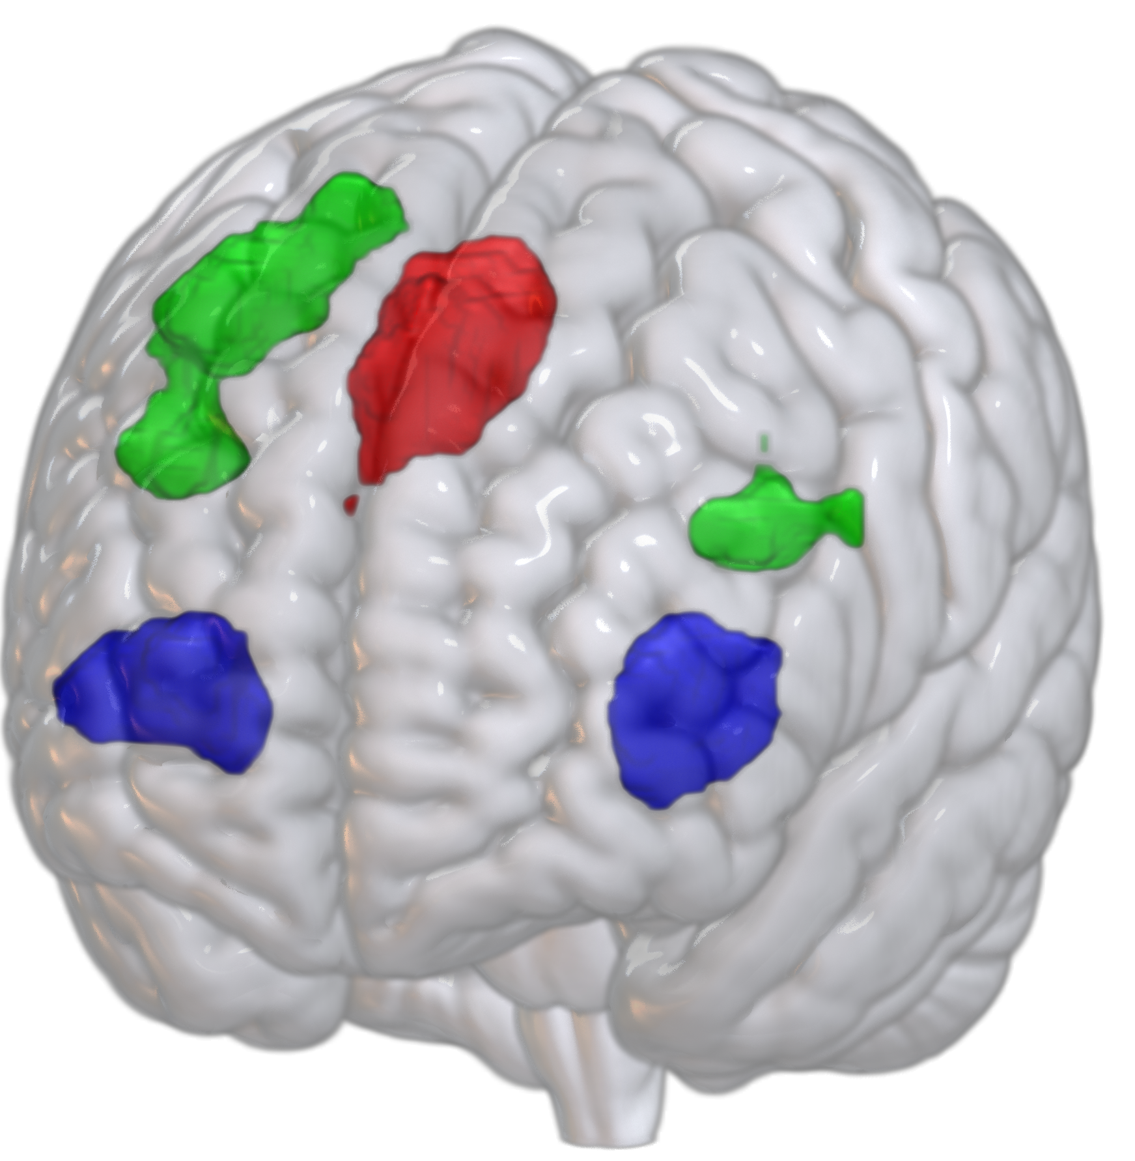
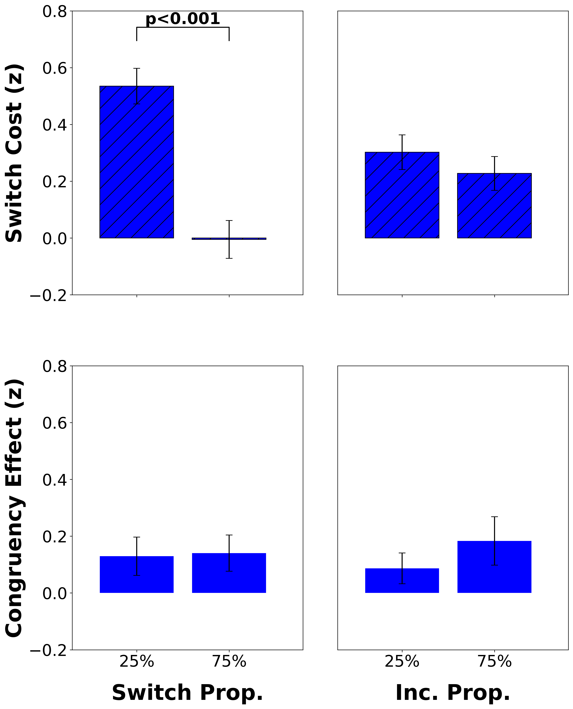
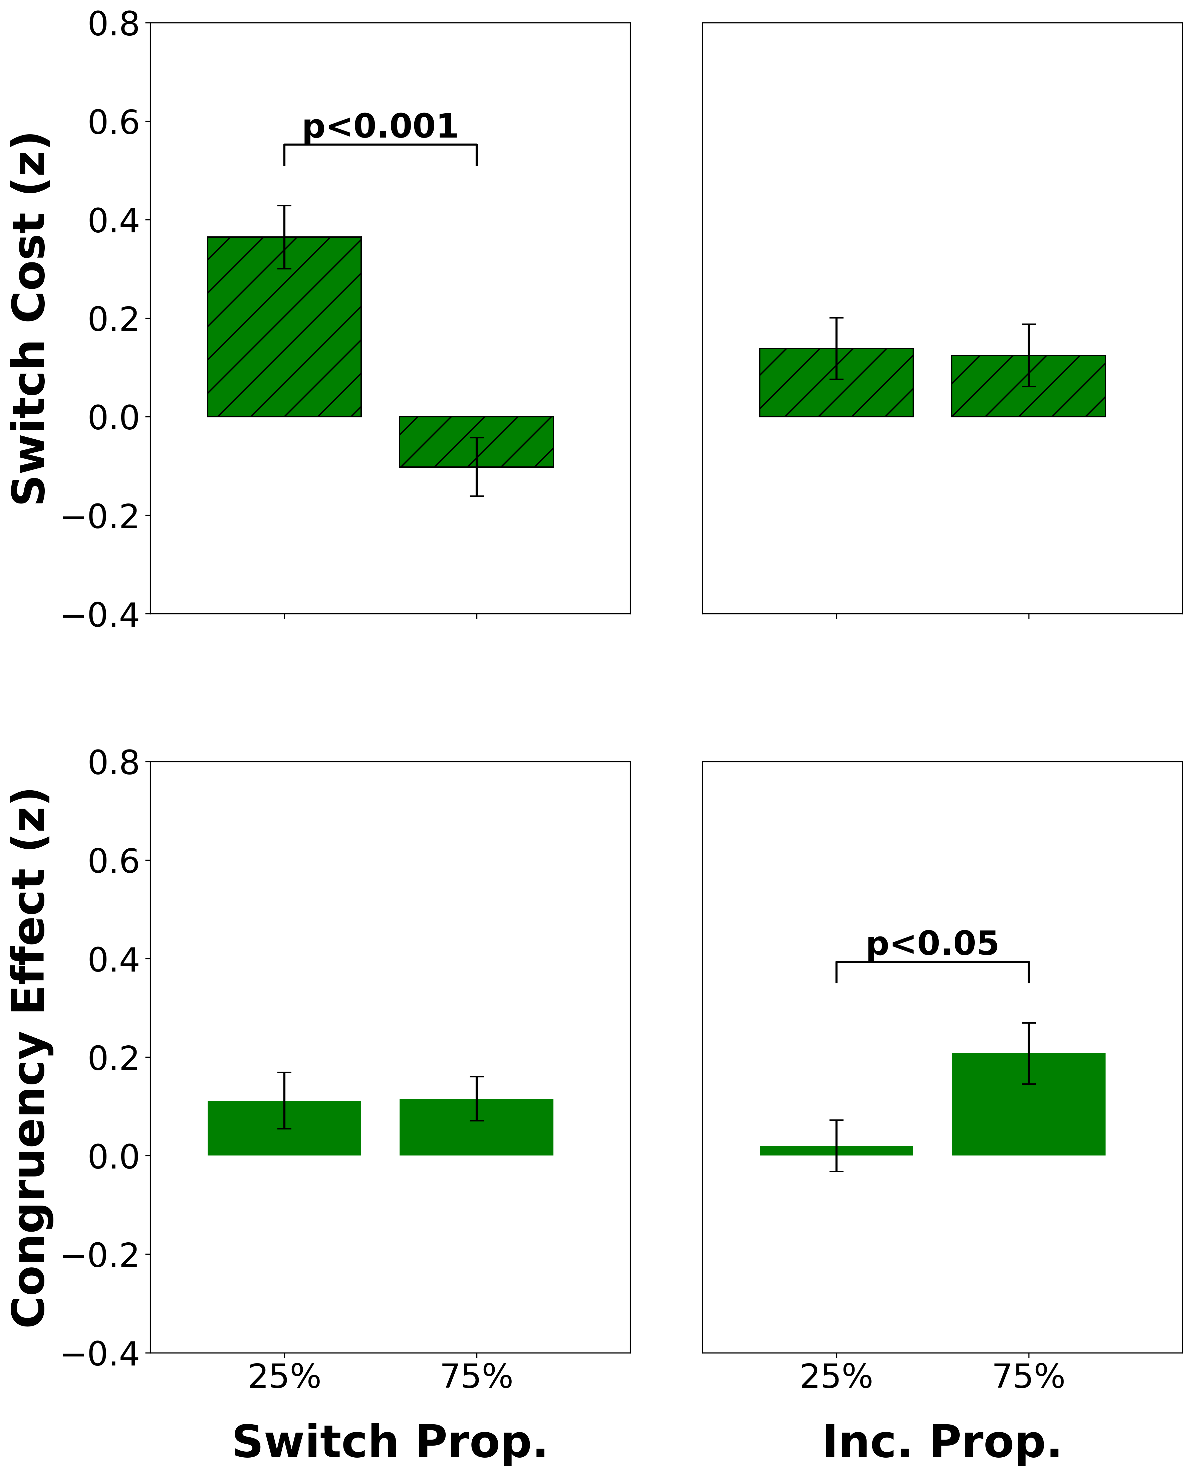
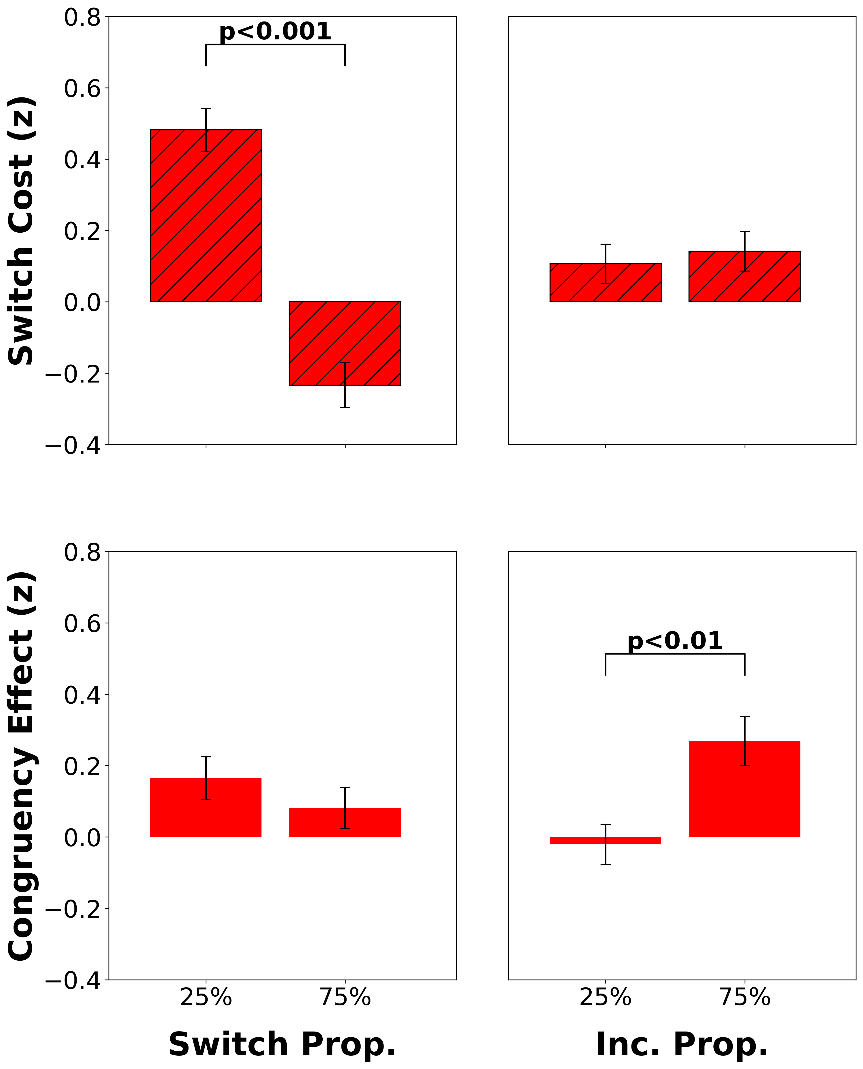
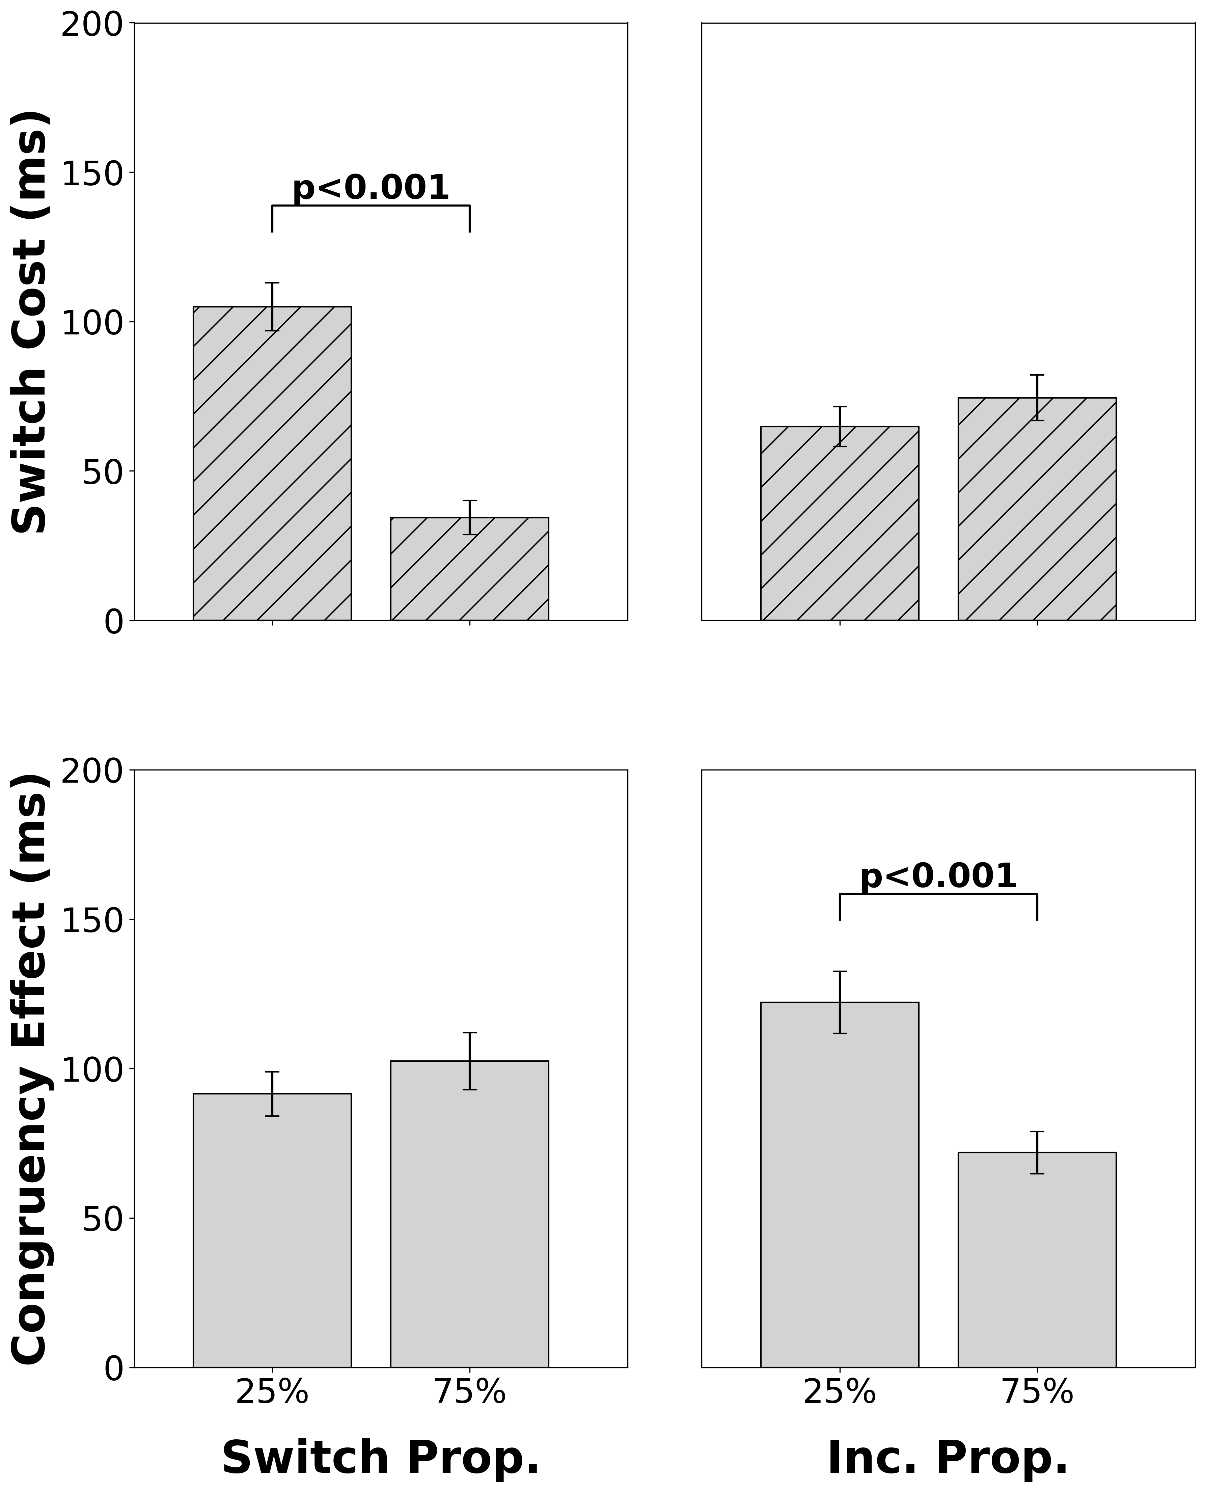
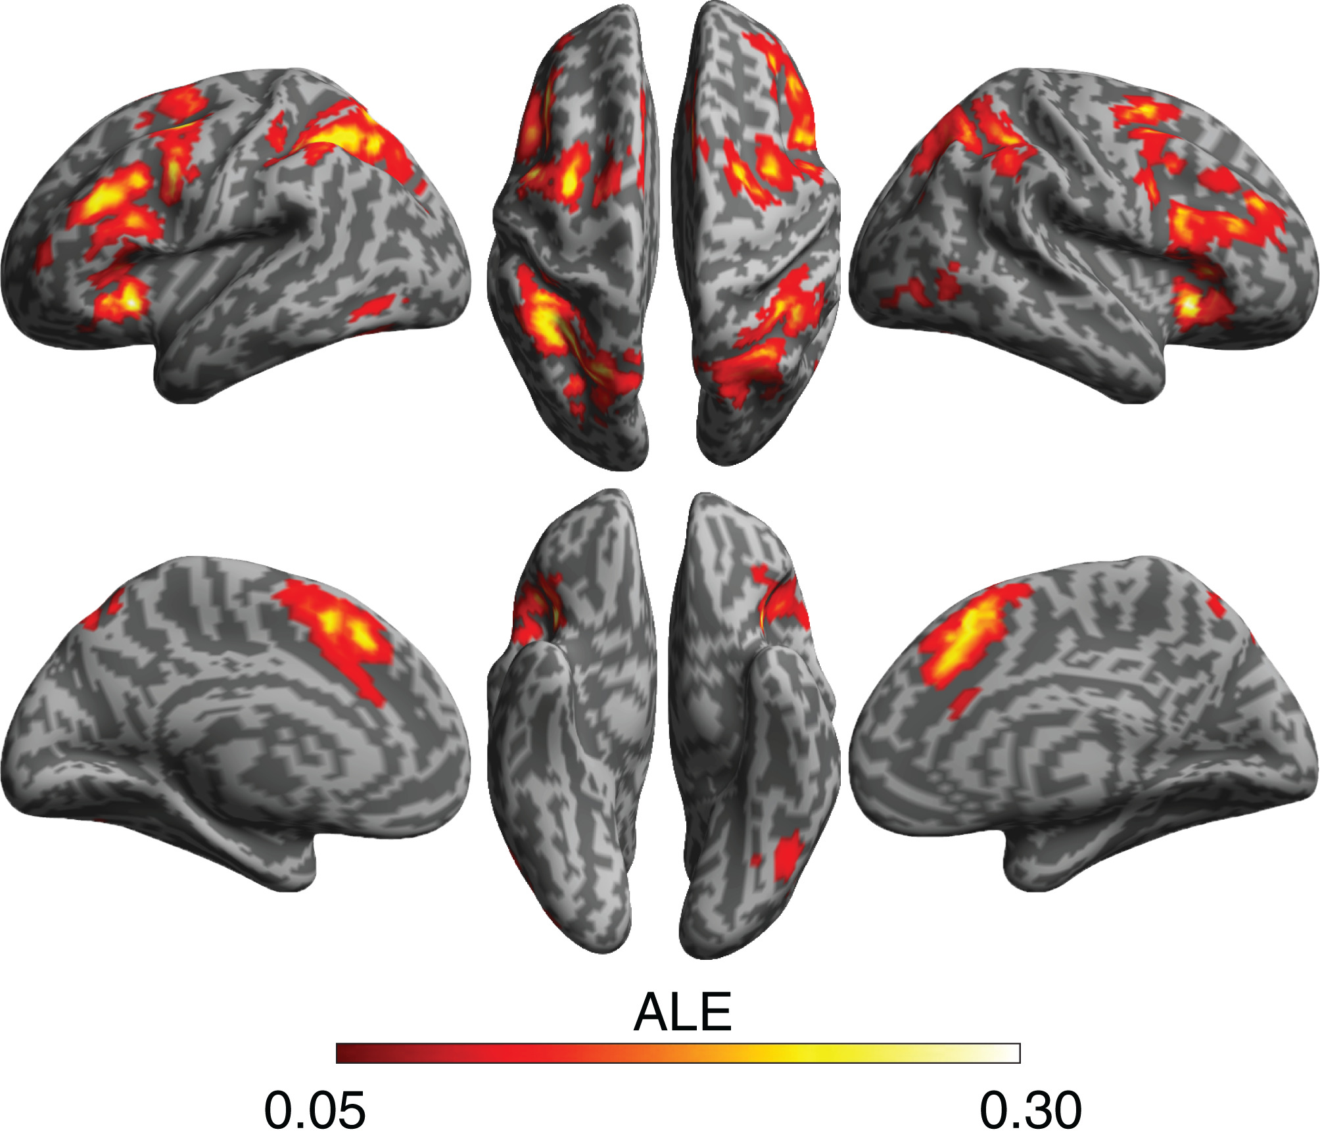
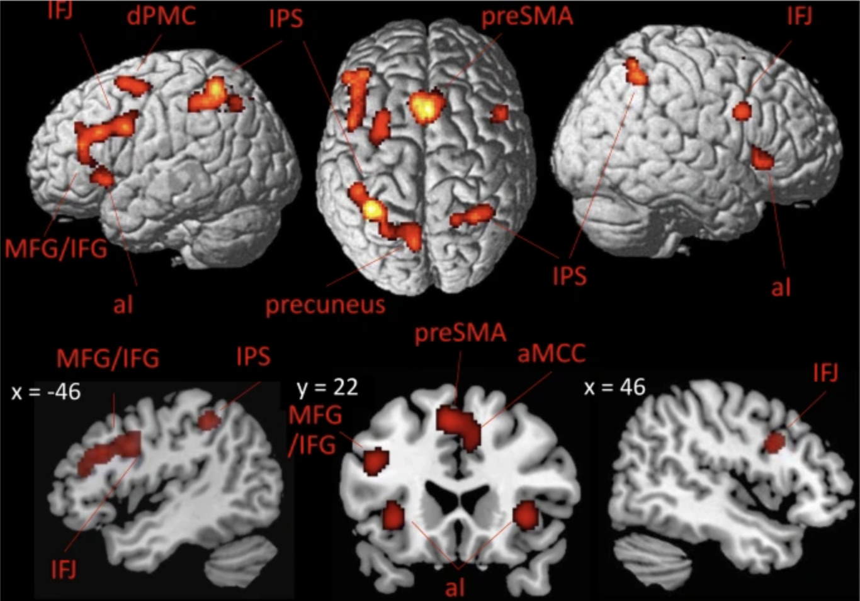
Intracranial EEG Correlates of Concurrent Demands on Cognitive Stability and Flexibility
Neural Correlates of Concurrent Demands on Cognitive Stability and Flexibility
Jinjiang Zhang^{1,2}, Raphael Geddert^{1,2}, Roshni Ammanamanchi^{1,2}, Andrew Michael², Tobias Egner
Department of Psychology and Neuroscience¹, Center for Cognitive Neuroscience²
Duke University
Background
LWPS Significant Clusters
Cognitive stability (task focus) and flexibility (task switching) are two core capacities of cognitive control, yet their relationship and neural substrates are unclear^{1,2}
Previous studies have separately shown activation for stability and flexibility in lateral and medial frontal cortex^{3,4}, but whether they have distinct or shared neural substrates is still not known
Do cognitive stability and flexibility have distinct or shared neural substrates?
Methods
Participants completed a classic cued task switching experiment (n=45)
Repeat
Switch
2
7
1
…
Red Frame: Parity Task
Blue Frame: Magnitude Task
Congruent
Incongruent
👈🏽
< 5
even
> 5
odd
👉🏽
👈🏽
< 5
even
> 5
odd
👉🏽
Switch costs index flexibility.
Congruency effects index stability.
The proportion of incongruent and switch trials varied independently across block types
Block A
128 Trials
Block B
128 Trials
Switch proportion
Block C
128 Trials
Block D
128 Trials
Incongruent Proportion
Discussion
Behavioral Results
We detected both congruency sensitive sites and switch type sensitive sites, and these sites were spatially interspersed.
There are both distinct and overlapping/interactive effects of stability and flexibility detectable at the level of mesoscale neural recordings in LPFC.
More demanding trial conditions (incongruent, switch) induced greater activity in LPFC electrodes sensitive to those conditions
Future analyses will investigate how stability and flexibility are regulated through block proportion manipulations
Future work will also investigate the temporal differences between conditions
References/Acknowledgments
1. Egner 2023, Nat Rev Psychol. 2. Geddert and Egner 2022, Journal of Experimental Psychology. 3. Worringer et al. 2019, Brain Struct Funct. 4. Wu et al. 2020, J Comp Neurol. 5. Duraivel et al. 2023, Nat Commun. 6. Destrieux et al. 2010, Neuroimage.
Thanks to all members of the Egner lab for their guidance and support on this project
This work was funded by NIH Grant RO1 MH133550
CONTACT
jim.zhang@duke.edu
CONTACT
jim.zhang@duke.edu
Worringer et al., 2019
Wu et al., 2019

